Slide 1

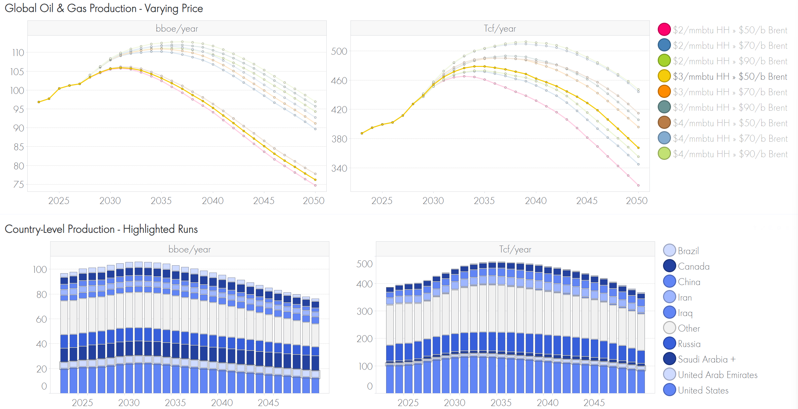
ENERGY & MARKET FUNDAMENTALS
Long-term Oil Supply Analysis
Modelling Oil Supply and Price for Operating Plan Screening Values (PSV)
SHAPE
CONNECT
ACCELERATE
Richard Baker, Tim Lottman, Assaf Mar-Or
SCA Global Team F2F 2026 | 7–8 September
Events this year remind us that disruptions to energy supply can have impacts that reverberate throughout the world and significantly affect the global economy. Shell’s Global Supply Model (GSM) has been continually developed over the last decade to model how Oil and Gas supply might develop in the coming decades under different commodity price and geopolitical scenarios
Our goal is to provide a long-term view on price to underpin long-term capital investments (PSV) and to provide a detailed geographical breakdown of supply to feed into Shell’s bespoke Regional Tension Tool (RTT) that delivers the Oil and Chemical Screening Values (OCSV)
A
Long-term liquids demand (excl. biofuels and processing gains)
Mb/d
B
Modelled supply under different pricing scenarios
Bboe/yr & Tcf/yr
High
Surge
Ref
Low
5% Decline
The team aligns on scenario drivers in Dec/Jan. OMA use a suite of models (e.g. Road Fleet Model) to provide demand reflecting different views on the pace of the energy transition. Global Scenarios (e.g. Surge) can also be used.
The GSM then models Oil, Condensate, NGL and Natural Gas production for 98 countries at the play-level, based on current production, cost of supply, resource base and constraints (e.g. sanctions). The aggregate global view is then compared to demand and the best matches selected.
C
Detailed waterfall showing supply changes to 2040 - Archipelagos
Mb/d
D
Example P50 Brent price in different demand scenarios
$/b RT25
1
+3.2
1
100
97
2
9
+8
High
13
+17
Surge
27
+27
Ref
Total
Low
Onstream - minimal intervention
Developed Resource - Incremental Capex i.e. WRFM
Undeveloped Resources - New Fields
2025
OPEC
Exploration
OPEC+
Non-OPEC
2040
The granularity of the data enables a wide range of applications. One is a clear view of growth drivers for the upstream industry; the role of resource maturation versus exploration and the capital investment required in different geographies.
Through integrating multiple demand and supply scenarios, the team can produce a robust assessment of the range of prices required to meet a particular demand scenario.
KEY LEARNINGS
Collaboration is critical. Teams across SCA and Trading both provide inputs and depend on the final product, so everyone needs clear visibility on what will be delivered and when.
Investment in the models is focused on faster, sharper workflows that are sophisticated enough to capture complexity, simple enough to run quickly, and clear enough to interpret. Our ORTEC colleagues are essential to keeping the model suite reliable, freeing the team to focus on analysis rather than debugging.
External perspective is indispensable. The team invests significant time engaging with vendors, service companies and internal experts. Some of the most valuable insights come from conference conversations providing signals that never appear in a database. As data becomes commoditised, judgement, networks and human insight will be the real differentiators.
Shape. Connect. Accelerate.
September 7–8, 2026

